Slide 1
MGB1201 Python Programming Project Phase – 2 2D Drawing Generation: Create basic 2D engineering drawings(orthographic, isometric, perspective)using libraries
Project Member 1: HARI RAJA T
Project Member 2: ARAVINTH BALA R

Slide 2
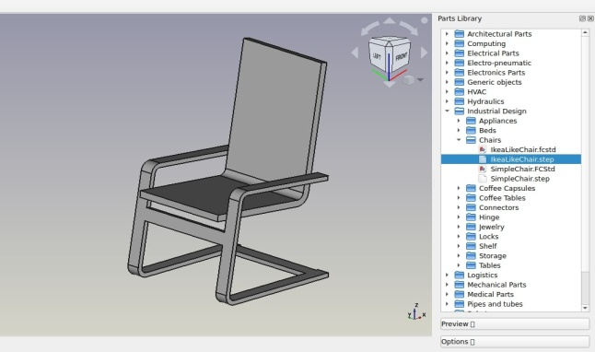
Introduction
2D Drawing Generation: create basic 2D Engineering Drawing using libraries
Key points:
Problem statement: The goal is to create basic 2D engineering drawings such as line diagrams, circuits, or simple mechanical parts using Python libraries like Matplotlib or Plotly
Target audience: Engineers, CAD designers, educators, and Python enthusiasts.
Project goals: To automate the generation of 2D drawings using code, reducing manual effort and offering easy modifications.

Slide 3
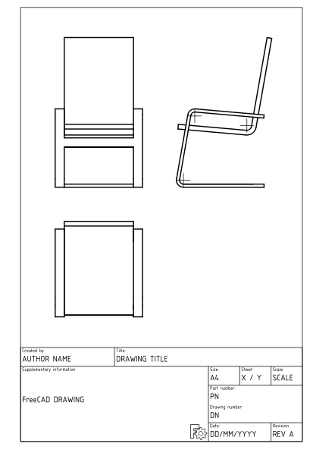
Empathy and Design Challenge
Title: Understanding User Needs
Key points:
User research findings:
CAD designers, it became apparent that manually modifying 2D drawings is time-consuming
Furthermore, many users lack access to or experience with advanced software such as AutoCAD.
Design challenges identified:
Ensuring precision while keeping the user interface or API simple.
Allowing flexibility for various drawing shapes and forms.

Slide 4
Ideation and Prototyping
Title: Brainstorming Solutions
Key points:
Innovative ideas generated:
Python Integration: Using Python libraries to create 2D drawings easily through scripts.
Shape Templates: Developing a library of basic shapes (lines, circles, rectangles) that can be parameterized and combined into more complex forms.
Scalability: Ensuring the code can handle drawings of various sizes and scales.
Prototype development process :
Step 1: Shape Creation: Start by generating individual shapes like lines and circles using Mat plotly.
Step 2: Parameterization: Allow users to define the size, position, and orientation of shapes.
Step 3: Combination of Shapes: Implement functionality to combine multiple shapes into complex designs.
Step 4: Visual Output: Display the 2D shapes using Python's rendering capabilities.
Step 5: Export Options: Develop export functionalities to save drawings in popular formats (PDF, PNG).

Slide 5
Testing and Iteration
Title: User Testing and Feedback
Key points:
Testing results :
The prototype was tested for generating standard 2D shapes like rectangles and circles.
It was able to handle different size inputs and correctly display the shapes.
Iteration made based on feedback :
A grid layout was added to allow users to align objects precisely.
Users can now add labels to drawings, which is crucial for engineering blueprints.

Slide 6
Python Programming Work Methodology Flowchart
start
Understand the drawing Requirements
(2D shapes)
Initialize Drawing
(program the 2D shapes based on input )
Test and Iterate
(test the shapes for accuracy and make necessary changes
Choose Python library
(Matplotlib/plotly)
Final Deployment

Slide 7
Literature Review & Problem Identification
Key Points:
Summary of relevant research and existing solutions:
Traditional CAD software like AutoCAD is widely used.
steep learning curve and high cost.
Identification of research gaps or unsolved problems:
A gap exists in integrating automated 2D drawing generation with Python, specifically for engineering use cases.
-Existing solutions don’t address the need for simplicity while maintaining the precision necessary for engineering applications.
Explanation of how the project addresses these gaps:
This project combines Python’s accessible programming environment with powerful visualization libraries Matplotllib to offer a customizable and efficient drawing solution.

Slide 8
Tentative Experimental Plan, Future Work.
Title: Project Timeline and Future Directions
Key Points:
Requirements Gathering :: Gather all necessary specifications, including dimensions, tolerances, and standards for the drawings
Software Selection :Select appropriate CAD software for generating 2D drawings.

Slide 9
Gantt Chart Template
Task | Start Date | End Date | Duration | Status
Task 1 | [23.09.24] | [24.09.24] | [24hrs] | [COMPLETED]
Task 2 | [Start Date] | [End Date] | [Duration] | [Status]
Task 3 | [Start Date] | [End Date] | [Duration] | [Status]
Task: A task is a specific activity or job that needs to be completed.
Status: [Legend for different status indicators, e.g., Completed, In Progress, Not Started]

Slide 10
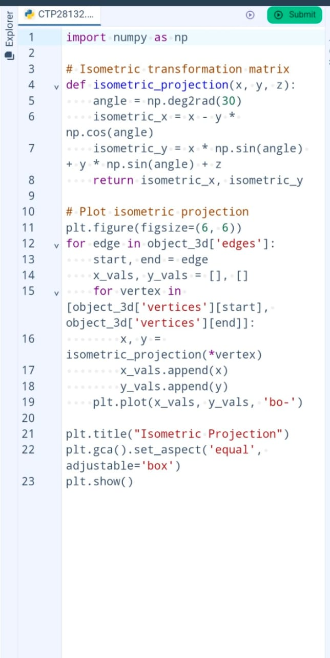
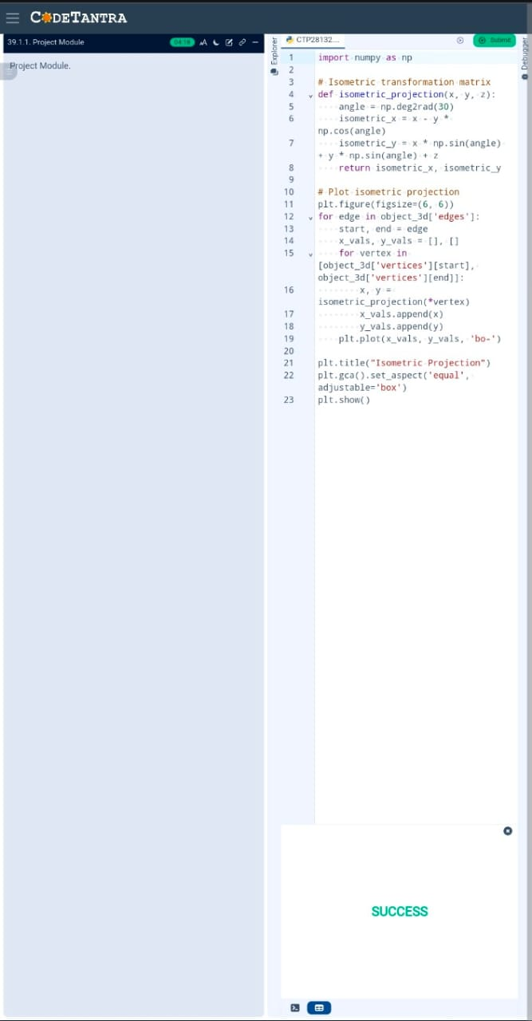
SCREENSHOTS

Slide 11
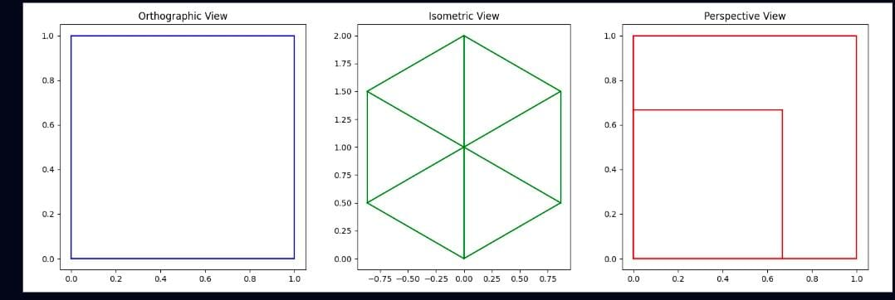
OUTPUT

Slide 12
Conclusion and Future Directions
Key points:
Summary of project achievements:
Successfully developed Python code to generate customizable 2D drawings using Mat plot lib .
Implemented export functionality for common formats such as PNG and PDF.
Future plans or recommendations:
Integrate more complex shapes and provide functionality to handle layers of drawings.
Consider expanding the scope to include 3D drawing generation

Slide 13
Reference
Choi, J. A Study on the Development of Code Checking System for Building Administration Process Applying Open BIM-based Process, M.A. Thesis, Kyung Hee Univ., 2014

